Slide 1
Distracted Driver Detection
Sujeeth Shetty

Slide 2
Problem Statement
The United States Department of Transportation states that one in five car accidents are caused by distracted drivers.
Distracted driving caused injuries to 400,000 people and claims the lives of 2,841 just in 2018
2.9% of the driver using handheld cell phones in 2017, which was down from 3.3% in 2016
Teens are 4x more likely to be in a wreck than driver over age 30
One efficient way to reduce car accidents is to prevent distracted driving, which is the act of driving while engaging in other activities such as texting, talking on the phone, etc.

Slide 3
Introduction
To improve the alarming statistics of car accidents, an algorithm will be developed to detect drivers engaging in distracted behaviors by feeding it dashboard camera images.
This algorithm can then be used as an API in a device to classify the driver’s behavior by checking if they are driving attentively, wearing their seatbelt and remind them if they are not
The input of this model is images of the driver taken in the car.
The most efficient way to tackle the problem at hand is to develop a neural network model and then train it on a training subset of the dataset with the objective to obtain a high-accuracy model

Slide 4
Data Exploration
The Dataset has a set of images of drivers taken inside a car capturing their activities such as texting, talking on the phone, eating, reaching behind, putting on makeup, etc
The dataset contains a total of 102150 images split into a training set of 22424 images and a testing set of 79726 images. Here is a sample of the dataset images.
The images are 480 X 640 pixels and the distribution of the classes in the training set are relatively uniform

Slide 5
Algorithm
Convolutional Neural Networks (CNN or ConvNet) are complex feed forward neural networks.
CNNs are used for image classification and recognition because of its high accuracy
Project was executed using a CNN of ‘keras’ Package in R
Keras framework is integrated with Tensorflow engine, its user friendly, easy to learn and easy to build model
Keras is designed for human beings, not machines, and follows best practices for reducing cognitive load.

Slide 6
Preprocessing
The training set which holds 22424 images has taken over 20 GB of memory and the test set has a memory of 61 GB which holds 79726 images with no labels
Batches of tensor image data were generated by splitting the entire training dataset into the validation set and another 50% for training the model
the images were first resized to 256 x 256 pixels from 480X640 pixels, then converted into a 3D tensors and then into a 4D tensors of shape (N, 256, 256, 3) where N is the number of images
The tensors were scaled by dividing them over 255

Slide 7
Implementation
The final model was implemented using keras Sequential function and adding a Convolutional layer of 16 filters, kernel size 2X2, same padding, relu activation, and input shape the same as the 4D tensors that are (None, 256, 256, 3).
The model had 3 hidden layers with relu activation and filers of 128,64 & 64 respectively
The model was regularized by adding the Dropout layer of rate 0.2 followed by a Flatten layer
The output had a Dense layer of 10 outputs representing the data classes with a softmax activation

Slide 8
Model Evaluation
The performance was relatively good although it was a simple model and only trained for 10 epochs
In terms of accuracy, it achieved 99.5% in training and 100% in the validation set with loss of 0.021 & 0.003 respectively

Slide 9
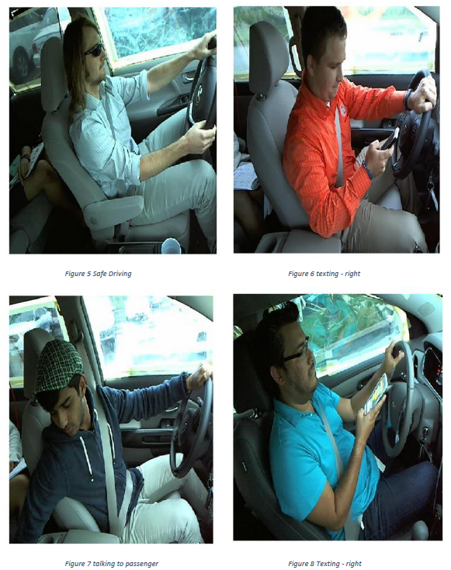
Result
The model was tested by randomly selecting the images from the test dataset. The algorithm was able to identify a wide range of distracting activities.

Slide 10
Conclusion & Future work
In conclusion, a three-layer Neural Network model was successfully implemented that has great performance on the distracted driver detection task and gives a validation accuracy of 100%.
For the future improvement of these self-implemented models, a more sophisticated weight initialization method like Xavier Initialization or LeCun uniform Initialization can be applied
Besides, the dataset also provides 77,000 test images without labels, so if these images are labeled or use a semi-supervised learning method, this model could be developed with these images
Pre-trained CNN-based models like ResNet or VGG can be used to get a better result.

Slide 11
References
[1]D. G. Kidd, N. K. Chaudhary, "Changes in the sources of distracted driving among Northern Virginia drivers in 2014and 2018: A comparison of results from two roadside observation surveys”, Journal of Safety Research2019,69,131-138;doi: 10.1016/j.jsr.2018.12.004
[2]R.L. Olson, R.J. Hanowski, J.S. Hickman, J. Bocanegra. Driver Distraction in Commercial Vehicle Opera-tonus’s. Department of Transportation, Washington, DC. Data available online since September 2009 on:https://www.fmcsa.dot.gov/sites/fmcsa.dot.gov/files/docs/FMCSA-RRR-09-042.pdf

Slide 12
Thank you

